Slide 1
Week 10 Polymorphism

Slide 2



Outline
Polymorphism
Encapsulation

Slide 3
Polymorphism
Polymorphism – from Greek (polys - many) (morphe - shapes, forms) – ‘many forms’
In Biology, it is applied to species that can take different forms
In object-oriented programming, it refers to accessing objects of different types through a common interface
Polymorphism in Java is closely related to the inheritance mechanism
Many different ways of implementing polymorphism in our programs

Slide 4
Polymorphism: Method Overloading
In this example, the max() method of this MathUtil class is overloaded
Three definitions, each of which performs the same task but on different input types
The methods are distinguished by their method signature, which must be unique within the class
Polymorphism: many forms of the max method
public class MathUtil {
static int max(int num1, int num2) {
// Code to find the max of the two integer numbers
}
static double max(double num1, double num2) {
// Code to find the max of two floating-point numbers
}
static int max(int[] numbers) {
// Code to find the max of an array of ints
}
}
max ( int, int )
max ( double, double )
max ( int[] )
Method Signature – Combination of the method name and order/type of parameters

Slide 5
Polymorphism: Overloaded Operators
The + operator in Java is overloaded – it does different things depending on the context
The + operator is the only operator in Java which is overloaded (e.g. we can’t multiply (*) one string by a number)
int num1 = 10 + 20; // 30 - Adds two integers
double num2 = 15.6 + 3.2; // 18.8 - Adds two floating-point numbers
String str = "Hello," + " world!"; // “Hello, world!” - Concatenates two strings

Slide 6
Lab Exercises
Exercise 1: Method Overloading

Slide 7
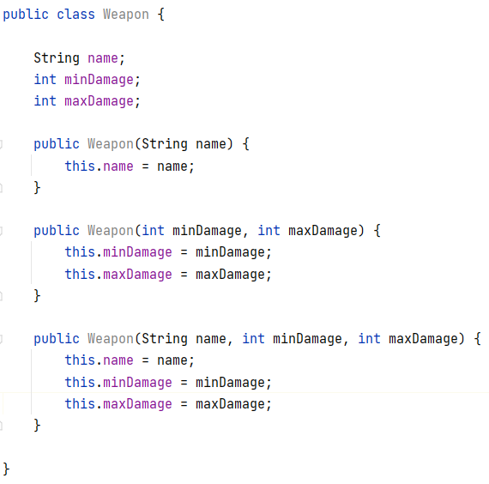
Polymorphism: Constructor Overloading
Constructor overloading refers to having multiple constructors in a single class where each constructor has a different signature
Signature -> the data types of the parameters and their order
Polymorphism: many forms of the class constructor

Slide 8
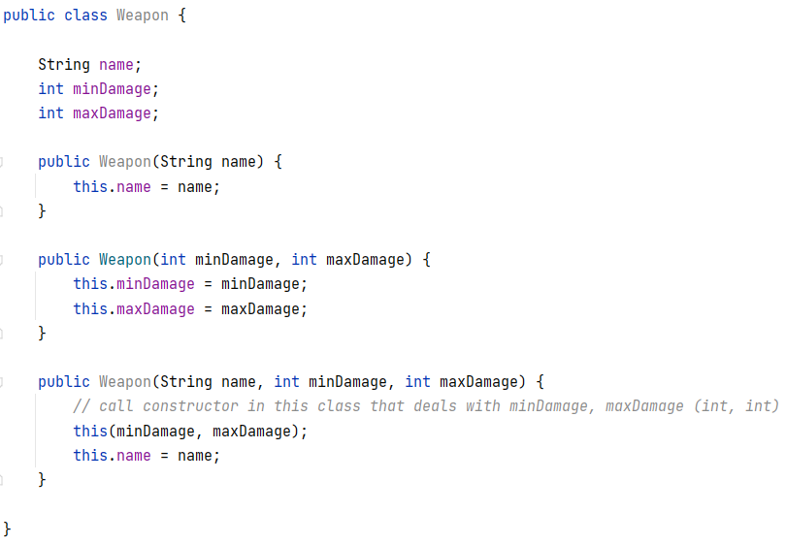
Polymorphism: Constructor Overloading
Constructors in the same class can also call each other using this()
Similar to using super() in a constructor to call the superclass constructor

Slide 9
Lab Exercises
Exercise 2 : Constructor Overloading

Slide 10
Polymorphism: Inclusion
Inclusion Polymorphism occurs when a piece of code which is written to work for one type (class) works for all of its subtypes (subclasses)
Also known as subtype or subclass polymorphism
If a method accepts a reference to a Person object, it can also accept a reference to a Student or Academic object, since they are more specific types of a Person
An ArrayList<Person> would expect a reference to a Person object when the add method is called, but we could freely pass in a Student or Academic, since a Person includes its more specific examples
Polymorphism: many forms of a Person
Person
Student
Academic

Slide 11
Polymorphism
Assume the inheritance hierarchy below from the Inheritance lecture last week
Person
name : String id : int
print() : void
Student
department : String degree : String
print() : void
Academic
subject : String
print() : void
Side note: Method overriding is also a type of polymorphism! Many forms of the print method exist!

Slide 12
Polymorphism
// assume we’re in a class & method with import statement for ArrayList
ArrayList<Person> facultyMembers = new ArrayList<>();
// Academic constructor: name, id, subject
facultyMembers.add( new Academic ("Lewis", 1234, "Programming") );
// Student constructor: name, id, dept, course
facultyMembers.add( new Student ("John", 2345, "Comp & Maths", "Comp Science") );
facultyMembers.add( new Student ("Alice", 3422, "Engineering", "Mech Engineering") );
// enhanced for loop,
// ask each element to print
for (Person p : facultyMembers) {
p.print();
}
Anonymous Object – don’t need to ‘name’ the object
facultyMembers
Index
Value
0
1
2
faculty
Members[0]
faculty
Members[1]
faculty
Members[2]
name
“John”
name
“Alice”
name
“Lewis”
id
2345
id
3422
id
1234
dept
“Comp & Maths”
dept
“Engineering”
subject
“Programming”
course
“Comp Science”
course
“Mech Engineering”

Slide 13
Lab exercises
Exercise 3 – Polymorphic Array

Slide 14

Encapsulation
We’ve seen encapsulation a lot, but we’ve not really used the word
Encapsulation is the act of bundling one or more items into a container
Java supports encapsulation in several ways, some examples include:
Bundling data and methods that operate on the data in an entity called a class
Objects of a class (instances) encapsulate their state within the object – one object’s attributes are considered separate from another object’s
Bundling one or more logically related classes in an entity called a package
Class
Methods
Variables

Slide 15
Data Hiding
Data Hiding in object-oriented programming means not giving the outside world access to the internals of a class
Classes communicate through the interfaces they expose through their public methods
The ‘inner workings’ (data and methods) should be hidden
Some reasons why this is a good idea:
You can completely change how a class works internally, but as long as the interface (i.e. names of the public methods) remains the same, you won’t break any other code that uses the class
Giving direct access to class data means external code can put an object into an internally inconsistent state – access through methods allows you to ensure internal consistency at all times

Slide 16
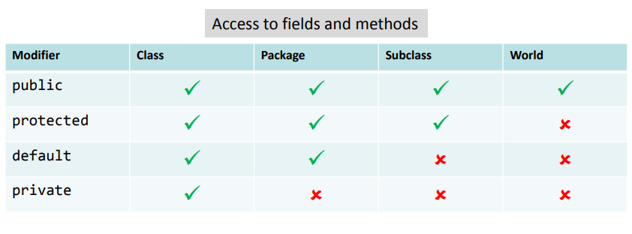
Data Hiding
We saw how data hiding was achieved in the Week10B webinar – using Java’s access modifiers
public – anyone can read/write the data, or call the method
protected – access is limited to within the class, package, or subclass
private – access is strictly within the current class, the data/method is hidden to subclasses (the data is there – it’s inherited – and may be accessible through getters/setters, but can’t be accessed directly)
Default (no specifier) – access is within the same package. Also known as package-private

Slide 17
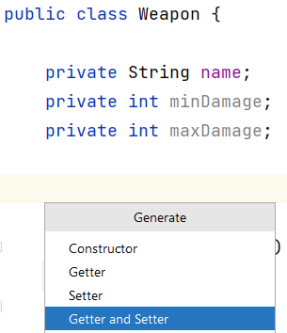
Data Hiding
It’s considered good practice to make instance variables private and provide public methods to access the data if it does need to be accessed from another class
These methods are commonly referred to as getters and setters
‘getter’ methods retrieve values (also called accessor methods)
‘setter’ methods set values (also called mutator methods)
IntelliJ can generate these methods for us (ALT+Insert shortcut), which can save time if there are many variables within a class that we need to specify access to

Slide 18
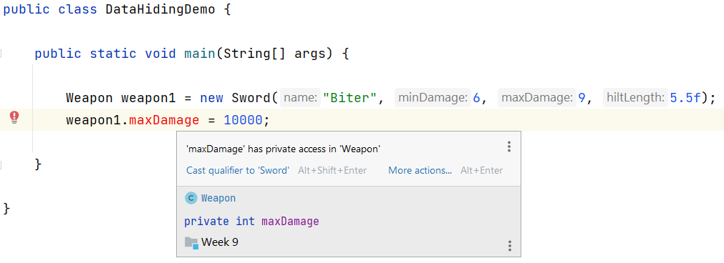
Data Hiding
A couple of things to note here:
We’re using the superclass name when declaring, but a subclass when initialising – this is allowed, since a Weapon could be any of its subtypes (Sword/Bow)
Can’t access maxDamage (it’s private)

Slide 19


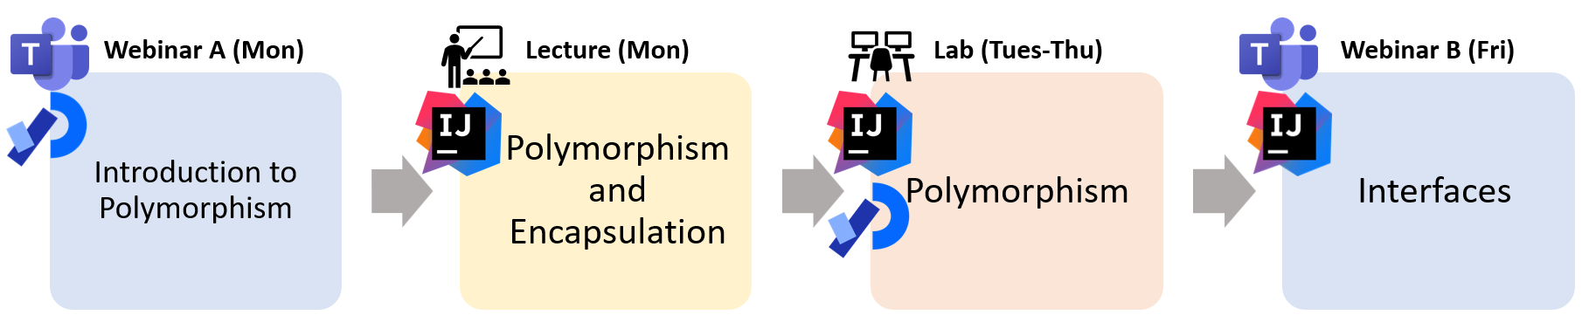
Summary
Polymorphism – many forms of something
Allows us to “program in the general” as opposed to “programming in the specific” – let the execution environment decide what happens based on the object being invoked
Encapsulation – encapsulating data and methods in sensible entities (e.g. classes)
Data Hiding – concept of keeping data private and allowing access to data only through methods we define
Getters and Setters – refer to methods which get or set data within a class

